Slide 1


Possibility. Curiosity. Individuality.
IBM @ Q-Hack 2024
April 3 – 4, 2024
Mannheim, Germany

Slide 2







Introducing Your IBM Mentors for Q-Hack '24!
Anna-Lena Hanschke IBM Technology Technology Partner Specialist
Hans Hüppelshäuser IBM Consulting Healthcare Team
Isabell Schmidt IBM Consulting SAP S/4HANA BW & Analytics
Philipp Bohlen IBM Consulting Business Transformation
Raoul Baron IBM Consulting Business Transformation
@ annalena00_19088
@ hans_huepp
@ isabell_schmidt
@ philipp_ibm
@ raoul_baron
2

Slide 3


Today, IBM is the only company bringing together innovative technology and consulting services, backed by strong research expertise in our strategic technologies,
IBM Consulting
IBM iX
Hybrid Cloud
&
Artificial
Intelligence
IBM Client Innovation Center
IBM Technology
IBM Research
IBM @ Q-Hack 24 / © 2024 IBM Corporation
3

Slide 4










Over 100 years of world-changing progress
watsonx
First hires of women and people of color
Apollo 11 Moon Landing
First Magnetic Stripe
Online Apple Pay Function
1899
1928
1969
1973
1979
1981
2016
2019
2021
2023
Optimization of global rail networks
First ATM machines
Excimer Laser Surgery
CovPass
App
UPC
Barcode
Quantum
Computing
Q
IBM @ Q-Hack 24 / © 2024 IBM Corporation
4

Slide 5

You find IBM at 25 locations in Germany, Austria and Switzerland, including data, research and development centers.
Flensburg
Hamburg
Wilhelmshaven
Berlin
Magdeburg
Dusseldorf
Cologne
Erfurt
Chemnitz
Frankfurt
Walldorf
Boeblingen
Ehningen
Linz
Vienna
Munich
Wels
Salzburg
Zurich
Rueschlikon
Graz
Bern
Lausanne
Geneva
IBM @ Q-Hack 24 / © 2024 IBM Corporation
Lugano
5

Slide 6

Start your career @ IBM
Non-graduate and graduate opportunities
1
Extreme Blue
2
Master @ IBM
3
Jumpstart
4
Associate Program
IBM‘s best-in-class summer
internship program for
top talents
Duration: 12 weeks
Roles: GenAI Consultant and Data Scientist
Target: Develop a use case in an interdisciplinary team coached by experienced IBM AI experts.
Design the solution, develop a prototype and pitch it to business users.
A fixed salary for the duration of the contract.
Combine work experience with your studies (Part-time Master or work-study model)
Duration: 12-30 months
Roles: Various (Sales, TechSales, Consulting, Exec. Assistants…)
Working time: 38h /week (incl. 10h for studies)
Fixed monthly salary + Travel
expenses for university<>IBM
and tuition fees/semester fees
Covered (ESB, Hector School,
HHL)
Jumpstart is part of the Associate Program - a program for career starters in IT
Duration: 6 weeks Target: Start at your first client project in the field of data & AI immediately after completion.
Intensive training in the areas of data engineering, data warehouse, ETL, AI as well as cloud computing and Scrum.
Permanent position with
unlimited employment
Contract from day one.
Early Professional- / Trainee
Program in IBM Consulting
Duration: 2 years
Roles: Consultant, Data Scientist, Designer…
Target: Clear alignment of
skills through specific
career plan
Hired into one of three job
roles with a specific career pathway and opportunities.
Permanent position with
unlimited employment
Contract from day one.
IBM @ Q-Hack 24 / © 2024 IBM Corporation
6

Slide 7
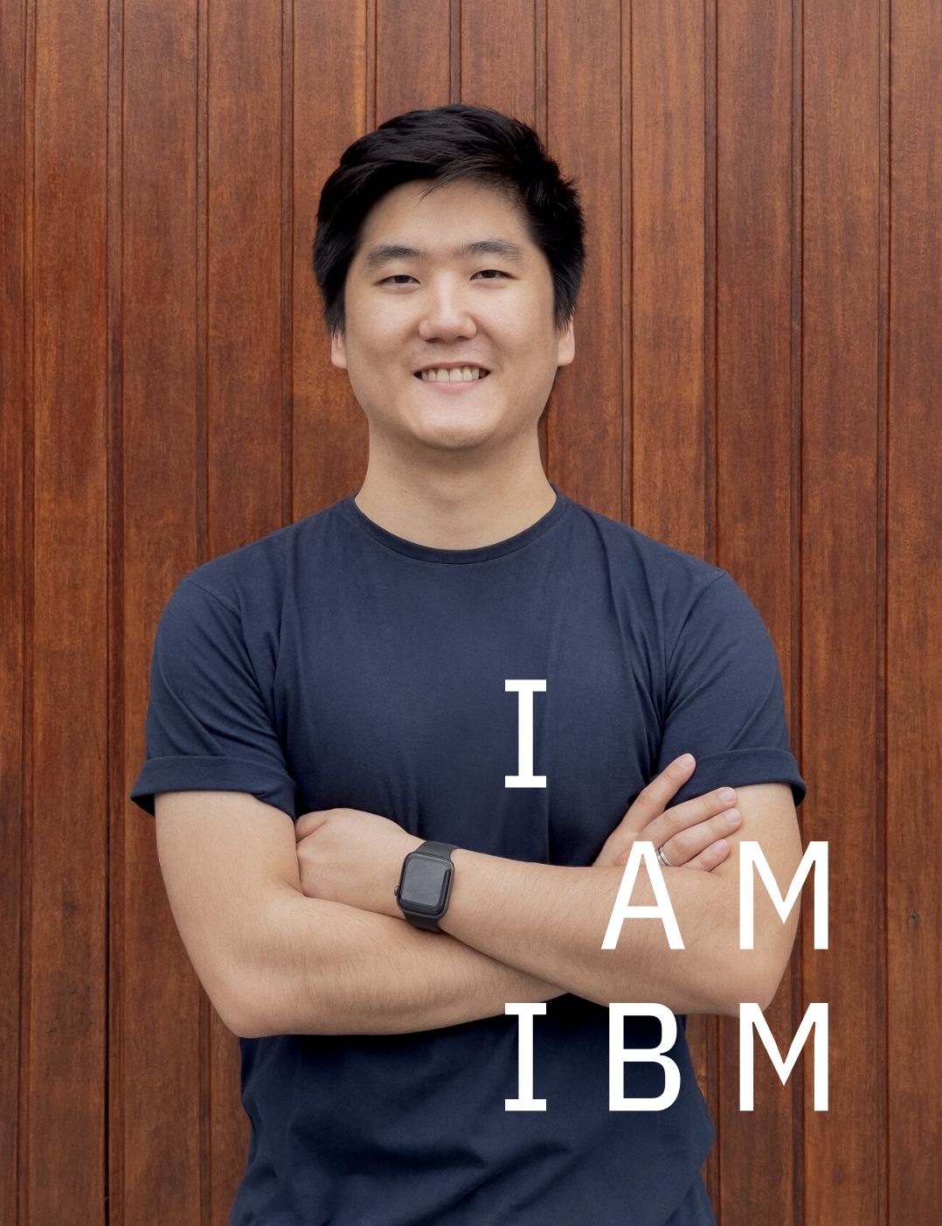
free for students and teachers,
just register with your university e-mail at: ibm.com/academic
IBM SkillsBuild Software Download many links to free IBM Data & AI Resources
Cloud Services
Watson Assistant
Natural Language Understanding
Visual Recognition
…. and much more.
Software
SPSS Modeller Premium
Cognos Analytics
ILOG CPLEX Optimization Studio
…. and much more.
Courses / Badges
Data Science Foundations
Python for Data Science
IBM Watson Studio - ML/DL made easy: Constraint Programming with ILOG
…. and much more.

Slide 8





Learn more about (Gen)AI and get your hands on
Hybrid Cloud and AI Platforms
A platform approach is the strongest enabler of digital transformation.
IBM offers flexible, secure, open hybrid cloud and AI platforms for a multi-cloud, multi-AI model world
watsonx
&
The industry’s leading unified hybrid cloud app platform
Enterprise-ready generative AI and data platform
IBM Workshop:
GenAI – between concepts, technology and trends
IBM Challenge:
AI for evidence-based decision making in the public space
IBM Careers:
↓
ibm.com/careers
IBM @ Q-Hack 24 / © 2024 IBM Corporation
8

Slide 9






Unleash AI Innovation: Your Challenge at Q-Hack '24
The Challenge
Artificial Intelligence for Evidence-Based Decision-Making in Public Spaces: Develop algorithms and models to analyze data from various sources to support informed decisions in policy areas such as healthcare, education, and environmental protection.
Outcome & Deliverables
Requirements
A Proof of Concept showcasing the feasibility of the solution and technologies applied.
A user-friendly interface tailored to a specific audience (Health, Environment, or Education).
A presentation deck that covers:
The addressed issue and an overview of the proposed solution.
A diagram illustrating the solution's architecture.
A video recording showcasing a demo of the prototype.
An evaluation of the solution's effectiveness and relevance.
An outlook detailing how the solution could be scaled and further developed.
Ideation / Design / Documentation | Implementation
Prototyping (Figma, InVision, XD, …) Diagrams (e.g. draw.io) | Large Language Models, Multi-Modal-Models Retrieval Augmented Generation, Embeddings, Semantic Search, Finetuning, GenAI + ML (hybrid approaches), Prompting Python, Pandas, LangChain ML Pipelines, MLOps
Evaluation criteria
Creativity | Relevance | Feasibility | Implementation | Presentation | Total
0-5 Points | 0-5 Points | 0-5 Points | 0-5 Points | 0-5 Points | 0-25 Points
IBM @ Q-Hack 24 / © 2024 IBM Corporation
9

Slide 10





Let’s stay connected.
Register to become part of our talent network or apply to one of our selected positions for Q-Hack.
ibm.com/careers
instagram.com/LifeatIBM
twitter.com/LifeatIBM
linkedin.com/company/IBM
For any immediate questions, feel free to reach out to us and have a chat during the event!
youtube.com/LifeAtIBM
IBM @ Q-Hack 24 / © 2024 IBM Corporation
10

Slide 11

×
Notes:
David

